Slide 1
Markov Models
Part 1
TBD

Slide 2
Disclosures and Disclaimers
The author has no relevant financial or nonfinancial relationships to disclose. During the development, analysis, and preparation of this presentation, the author was an employee of the Veterans Health Administration, U.S. Department of Veterans Affairs.
The views and opinions expressed in this presentation are those of the author and do not necessarily reflect the official policy or position of any agency of the U.S. government.

Slide 3
Outline
Limitations of decision trees
Markov model usefulness
Markov model features
Markov chain versus process
Probability and Rates
Discounting and Inflation
Markov models

Slide 4
Limitations of decision trees (1)
Chronic diseases have long time horizons
Can’t possibly capture all the re-entry points in a decision tree (becomes repetitive)
Markov re-entry nodes are convenient; decision branches are messy
Markov models are good alternatives to decision trees

Slide 5
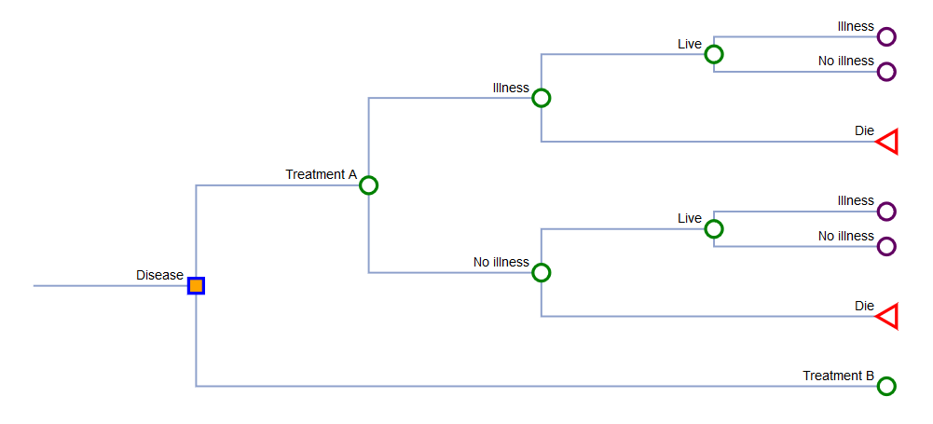
Limitations of decision trees (2)

Slide 6
Markov models (1)
Markov models are state-transition models
Useful when modeling chronic diseases
Each state represents a disease stage (or process)
Costs and benefits are assigned to each state

Slide 7
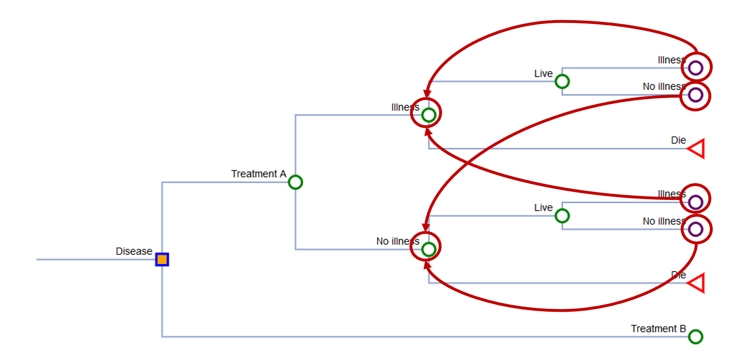
Markov models (2)
Well → Well
Well → Illness
Well → Death
Illness → Illness
Illness → Well
Illness → Death
Death → Death

Slide 8
Markov models (3)
Well
Illness
Dead
Asymptomatic state
Disease state
Absorbing state

Slide 9
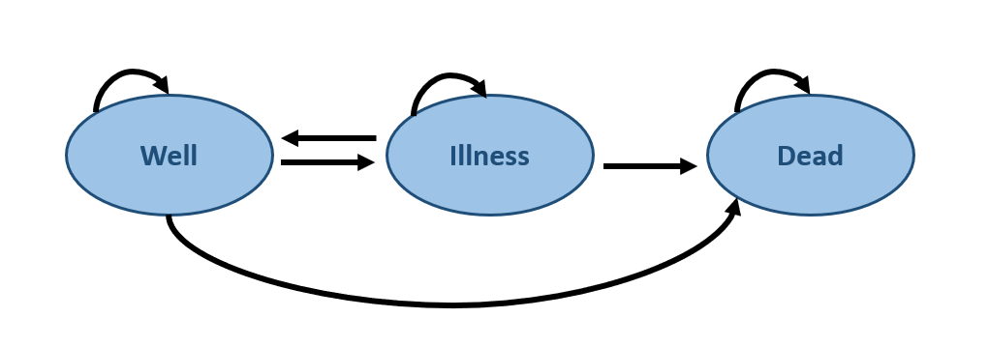
Markov models (4)
Well → Well
Well → Illness
Well → Death
Illness → Illness
Illness → Well
Illness → Death
Death → Death
tp1
tp2
tp3
tp4
tp5
tp6
tp7
100%
tp1
tp4
tp7
tp5
tp6
tp2
100%
tp3

Slide 10
Markov models (5)
If you have tp2 and tp3, then tp1 = 1 – tp2 – tp3
Well → Well
Well → Illness
Well → Death
Illness → Illness
Illness → Well
Illness → Death
Death → Death
tp1
tp2
tp3
tp4
tp5
tp6
tp7
100%
tp1
tp4
tp7
tp5
tp6
tp2
100%
tp3

Slide 11
Markov model features (1)
One iteration = Cycle
X-iterations = Time horizon
1 cycle
Time horizon

Slide 12
Markov chain versus process (1)
Markov chain – static transitions
Markov process – dynamic transitions
tp1
tp4
tp7
tp5
tp6
tp2
tp3

Slide 13
Markov chain versus process (2)
Markov chain – static transitions
Markov process – dynamic transitions
Transition probabilities remain static
If tp1 = 0.90 is cycle 1, then tp1 = 0.90 in cycle 2
tp1
tp4
tp7
tp5
tp6
tp2
tp3

Slide 14
Markov chain versus process (3)
Markov chain – static transitions
Markov process – dynamic transitions
Transition probabilities change from cycle to cycle
Although tp1 = 0.90 is cycle 1, tp1 = 0.85 in cycle 2
tp1
tp4
tp7
tp5
tp6
tp2
tp3

Slide 15
Markov chain versus process (4)
Markov chain – static transitions
Markov process – dynamic transitions
This is useful when the cohort will have a lower survival over a long period of time
tp1
tp4
tp7
tp5
tp6
tp2
tp3

Slide 16
Aside: Estimating probabilities
Using existing studies to estimate probabilities for decision models

Slide 17
Estimating transition probabilities (1)
Rate – Instantaneous likelihood of transition at any point in time (e.g., 5 events per 100 Person Years)
Probability – Proportion of a cohort that experiences the event over a specific period of time (e.g., 90% of patients had the event)
To get the transition probabilities in a Markov model using an existing study, estimate the rate, then estimate the probability for the time of interest using the rate

Slide 18


Estimating transition probabilities (2)
Estimating the probability from a study:
Probability from study → Rate → Probability for model
$$Rate= \frac{−ln⁡(1−p)}{t}$$
$$Probability=1−e^{−rt}$$
p probability
t time
r rate

Slide 19



Estimating transition probabilities (3)
If the 5-year probability of achieving a cure is 90%, what is the 1-year probability?
You can’t divide the 5-year probability by 5 (e.g., 90% / 5 = 18% to get the annual rate)
Probability from study
$$Rate= \frac{−ln⁡(1−p)}{t}$$
$$P(t)=1−e^{−rt}$$
P(5 years) = 90%
$$Rate= \frac{−ln⁡(1−0.90)}{5 years}=0.46$$
$$P\left(1 year\right)=1−e^{−\left(0.46\right)\left(1 year\right)}=0.37$$

Slide 20
Estimating transition probabilities (4)
Correct probability
0.90 @ 5 years
$$P\left(1 year\right)=1−e^{−\left(0.46\right)\left(1 year\right)}=0.37$$
Incorrect probability
$$P\left(1 year\right)=1−e^{−\left(0.18\right)\left(1 year\right)}=0.16$$

Slide 21

Estimating transition probabilities (5)
Suppose you had data from a meta-analysis where the relative risk of cure is 2.0 with a drug
What is the 1-year probability of cure using an annual rate of cure that is 0.47? (Hint: Is it not 2 x 0.47)
RR * rate
$$P(t)=1−e^{−rt}$$
2.0 X 0.47 = 0.94
$$P\left(1 year\right)=1−e^{−\left(0.94\right)\left(1 year\right)}=0.61$$

Slide 22
Back to Markov models
Markov cohorts and Microsimulations

Slide 23
Cohort versus Microsimulations (1)
Cohort simulation
Model a group of hypothetical patients at the same time
Time horizon is fixed
Computationally less intensive
Individual or microsimulations (Monte Carlo)
Individuals are modeled through the Markov models one at a time
Time for each patient can be short or long
Computationally intensive

Slide 24

Cohort versus Microsimulations (2)
Cohort simulation
Individual or microsimulations
Well
Illness
Dead
Initial
Well
Illness
Dead
Cycle 1
Well
Illness
Dead
Cycle 2

Slide 25
Cohort versus Microsimulations (3)
Cohort simulation
Individual or microsimulations
Well
Illness
Dead
Initial
Well
Illness
Dead
Cycle 1
Well
Illness
Dead
Cycle 2

Slide 26
Cohort versus Microsimulations (4)
Cohort simulation
Individual or microsimulations
Well
Illness
Dead
Initial
Well
Illness
Dead
Cycle 1
Well
Illness
Dead
Cycle 2

Slide 27
Cohort versus Microsimulations (5)
Cohort simulation
Individual or microsimulations
Well
Illness
Dead
Initial
Well
Illness
Dead
Memoryless (Markovian Assumption)
Cycle 1
Well
Illness
Dead
Cycle 2

Slide 28
Cohort versus Microsimulations (6)
Cohort simulation
Individual or microsimulations
Well
Illness
Dead
Initial
Well
Illness
Dead
Cycle 1
Well
Illness
Dead
Cycle 2

Slide 29
Cohort versus Microsimulations (7)
Cohort simulation
Individual or microsimulations
Well
Illness
Dead
Initial
Well
Illness
Dead
Cycle 1
Well
Illness
Dead
Cycle 2

Slide 30
Cohort versus Microsimulations (8)
Cohort simulation
Individual or microsimulations
Well
Illness
Dead
Initial
Well
Illness
Dead
Cycle 1
Well
Illness
Dead
Cycle 2

Slide 31
Cohort versus Microsimulations (9)
Cohort simulation
Individual or microsimulations
Well
Illness
Dead
Initial
Well
Illness
Dead
Cycle 1
Well
Illness
Dead
Cycle 2

Slide 32
Cohort versus Microsimulations (10)
Cohort simulation
Individual or microsimulations
Well
Illness
Dead
Initial
Well
Illness
Dead
Cycle 1
Well
Illness
Dead
Cycle 2

Slide 33
Cohort versus Microsimulations (11)
Cohort simulation
Individual or microsimulations
Well
Illness
Dead
Initial
Well
Illness
Dead
History of where the patient was before each cycle
Cycle 1
Well
Illness
Dead
Cycle 2

Slide 34
Discounting and inflation
Adjusting costs and outcomes for long time horizons

Slide 35
Discounting and inflation
Net Present Value: Current purchasing power of currency
Inflation
Discounting
NPV
tp
t0
tf

Slide 36


Discounting
What is today’s value of $1 10 years from now using a 3% discount rate?
$$V_{0}=\frac{V_{t}}{{\left(1+r\right)}^{t}}$$
$$\$0.74=\frac{\$1}{{\left(1+0.03\right)}^{10}}$$
V0 = Value in today’s term
Vt = Value at time t in the future
r = Discount rate
t = Time in the future

Slide 37
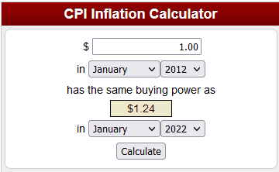
Inflation
What is today’s value of $1 from 10 years ago using the Consumer Price Index?
Use the CPI inflation calculator on the BLS website

Slide 38
Markov models using Excel
Tutorial on building Markov models in Excel

Slide 39
File location
You can download the Excel file here

Slide 40
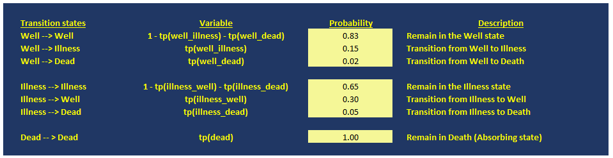
Setting up the Markov model
List all the transitions

Slide 41
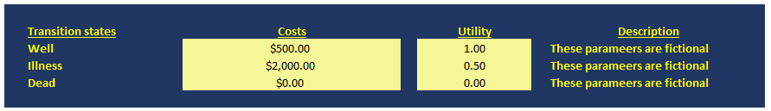
Assign costs and utilities to the states
Since the costs and utilities are specific to each state you can list them in a table

Slide 42
Model properties
Each cycle is 1 year
Simulate for 100 years (or 100 cycles)
Apply an annual discount rate of 3% on costs and outcomes

Slide 43
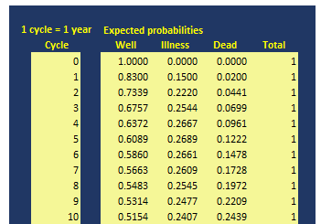
Calculating expected probabilities (1)
1 - tp(well_illness) - tp(well_dead)

Slide 44
Calculating expected probabilities (2)
tp(well_illness)

Slide 45
Calculating expected probabilities (3)
tp(well_dead)

Slide 46
Calculating expected probabilities (4)
Check to see that the probabilities sum to 1

Slide 47
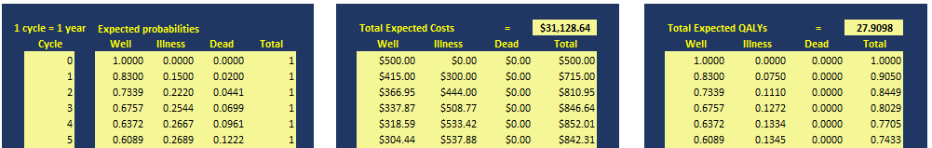
Calculating expected costs and utilities (1)
Expected costs at cycle 1 is 0.83 * $500 = $415

Slide 48
Calculating expected costs and utilities (2)
Expected costs at cycle 2 is 0.7339 * $500 = $366.95

Slide 49
Calculating expected costs and utilities (3)
Expected utility at cycle 1 is 0.83 * 1 = 0.83 QALYs

Slide 50
Calculating expected costs and utilities (4)
Expected utility at cycle 2 is 0.7339 * 1 = 0.73 QALYs

Slide 51
Calculating expected costs and utilities (5)
Sum the costs to get the total expected costs
Sum the QALYs to get the total expected QALYs

Slide 52
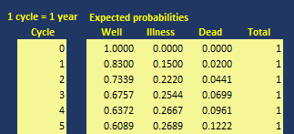
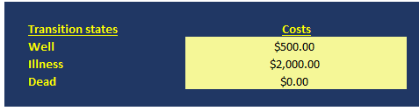
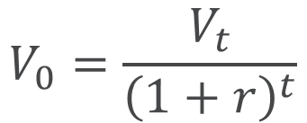
Applying discounting
$$V_{0}=\frac{V_{t}}{{\left(1+r\right)}^{t}}$$
r is the annual discount rate at 3%

Slide 53

Markov model results (1)

Slide 54
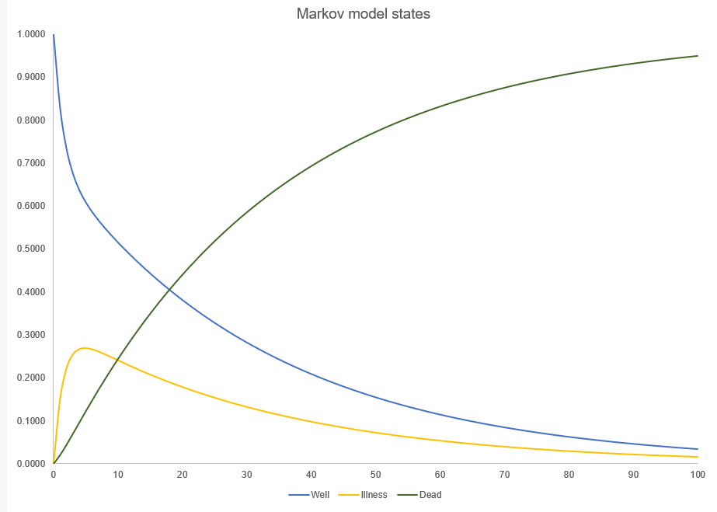
Markov model results (2)

Slide 55
Questions

Slide 56

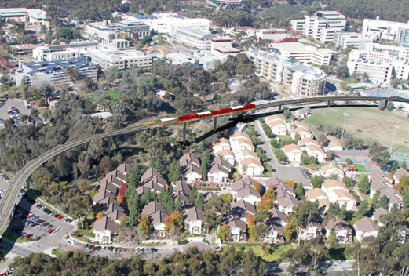
REFERENCES
Introduction to Markov Models

Slide 57

Thank you

